Slide 1
VIRTUAL MEMORY

Slide 2
VIRTUAL MEMORY
Virtual memory is a feature of an operating system that allows a computer to compensate for shortages of physical memory by temporarily transferring pages of data from random access memory (RAM) to disk storage.
It is a technique that allows execution of processes that are not completely in memory.
One of the major advantage of this scheme is that programs can be larger than the physical memory available.

Slide 3
VIRTUAL MEMORY
Reason to move pages of data from RAM to disk storage - Because OS was running out of RAM.
Solution: The operating system will need to move other pages to hard disk so it has space to bring back the pages it needs from temporary disk storage.
This process is known as paging or swapping and the temporary storage space on the hard disk is called a page file or a swap file.

Slide 4
VIRTUAL MEMORY
Separation of user logical memory from physical memory.
Program would no longer be constrained by the amount of physical memory that is available.
Because each program takes less space, more program could be run at the same time.
Less I/O would be needed to load or swap each user program into memory, Virtual memory can be implemented via:
  Demand paging
  Demand segmentation

Slide 5
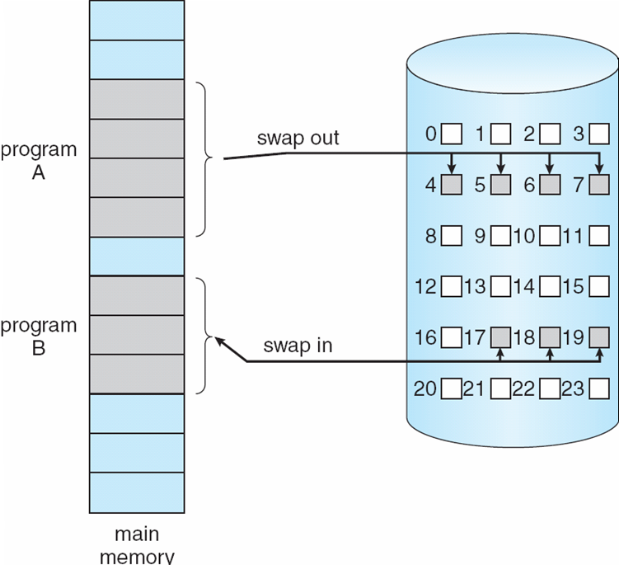
Transfer of a Paged Memory to Contiguous Disk Space

Slide 6
Demand Paging
Bring a page into memory only when it is needed
  Less I/O needed
  Less memory needed
  Faster response
  More users
Page is needed ⇒ reference to it
  not-in-memory ⇒ bring to memory
Lazy swapper – never swaps a page into memory unless page will be needed
  Swapper that deals with pages is a pager

Slide 7
Valid-Invalid Bit
With each page table entry a valid–invalid bit is associated
(v ⇒ in-memory, i ⇒ not-in-memory)
Initially valid–invalid bit is set to i on all entries
Example of a page table snapshot:
During address translation, if valid–invalid bit in page table entry
is I ⇒ page fault
Frame #
valid-invalid bit
v
v
v
v
i
….
i
i
page table

Slide 8
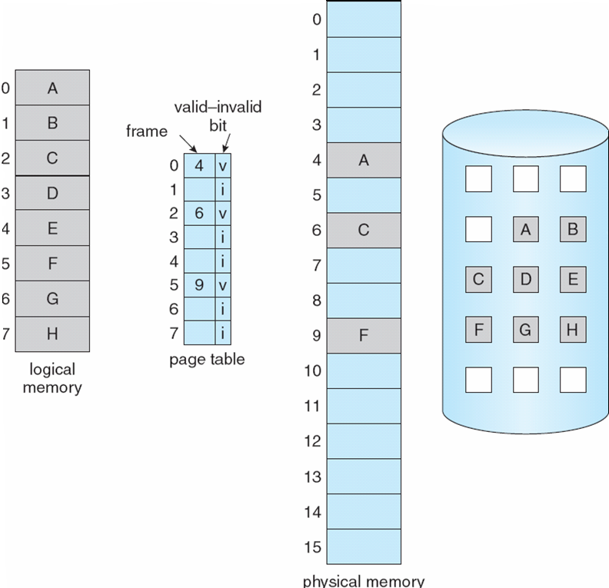
Page Table When Some Pages Are Not in Main Memory

Slide 9
Page Fault
If the required page is not available in Physical Memory: Page Fault
If there is a reference to a page, first reference to that page (if page is not available in physical memory) will trap to operating system: page fault
Get empty frame
Swap page into frame
Reset tables
Set validation bit = v
Restart the instruction that caused the page fault

Slide 10

Steps in Handling a Page Fault

Slide 11
What happens if there is no free frame?
Page replacement – find a page in memory and swap it out
  Replacement algorithm selects the victim page
  want an algorithm which will result in minimum number of page faults

Slide 12
Basic Page Replacement
Find the location of the desired page on disk
Find a free frame:
- If there is a free frame, then use it
- If there are no free frames, use a page replacement algorithm to select a victim frame
Bring the desired page into the (newly) freed frame, and update the page and frame tables
Restart the interrupted instruction of the process

Slide 13

Page Replacement
Use modify (dirty) bit to reduce overhead of page transfers
  If victim page is unmodified, then no need to write it back to disk

Slide 14
Page Replacement Algorithms
Want lowest page-fault rate
  Subsequently low page-fault service time too
Evaluate algorithm by running it on a particular fixed string of memory references (reference string) and computing the number of page faults on that string
FIFO page replacement
Optimal page replacement
LRU page replacement

Slide 15

FIFO Page Replacement

Slide 16

Graph of Page Faults vs Number of Frames
Expected behavior of a good page replacement algorithm.

Slide 17
First-In-First-Out (FIFO) Algorithm
Reference string (12 total refs / 5 unique): 1, 2, 3, 4, 1, 2, 5, 1, 2, 3, 4, 5
3 frames (3 pages can be in memory per process)
4 frames (3 pages can be in memory per process)
Belady’s Anomaly: More frames may yield more page faults
1
1
4
5
2
2
1
3
9 page faults
3
3
2
4
1
1
5
4
2
2
1
5
10 page faults
3
3
2
4
4
3

Slide 18

FIFO Illustration of Belady’s Anomaly

Slide 19
Optimal Algorithm (Called OPT or MIN)
Replace page that will not be used for longest period of time in future
4 frames example
1, 2, 3, 4, 1, 2, 5, 1, 2, 3, 4, 5
How do we know which page will be used latest?
  We don’t! OPT is impossible to implement accurately unless the order of page references is known a priori
1
4
2
6 page faults
3
4
5

Slide 20

Reference to page 2 replaces page 7, because page 7 will not be used until reference 18, whereas page 0 will be used at 5, and page 1 at 14.
The reference to page 3 replaces page 1, as page 1 will be the last of the 3 pages in the memory to be referenced again.
With only 9 page faults, OPT is much better than FIFO algo. Which results in 15 faults.

Slide 21
LRU replacement
The key distinction between FIFO and OPT(other than looking backward versus forward in time) is that FIFO algo uses the time when a page was brought into the memory whereas Opt algo uses the time when a page is to be used.
If we use recent past as an approximation of the near future, thus we can replace a page that has not been used for the longest period of time in past.
This approach is LEAST RECENTLY USED(LRU) algorithm.
LRU replacement associates with each page the time of the page’s last use. When a page is to be replaced, LRU chooses the page that has not been used for the longest period of time.

Slide 22
Least Recently Used (LRU) Algorithm
Reference string: 1, 2, 3, 4, 1, 2, 5, 1, 2, 3, 4, 5
Considered good, but difficult to implement
LRU does not suffer from Belady’s anomaly
1
1
1
1
5
2
2
2
2
2
3
5
5
4
4
4
4
3
3
3

Slide 23

LRU Page Replacement

Slide 24
LRU Algorithm – Implementations
Counter implementation
  Every page entry has a counter; every time page is referenced through this entry, copy the clock value into the counter
  When a page needs to be replaced, linear search the counters and select the minimum value as the victim
Stack implementation
  Keep a stack of page numbers in a doubly-linked form:
  Page referenced:
    move it to the top

Slide 25

Stack Records Most Recent Page References

Slide 26
LRU Approximation Algorithms
Few computers provide sufficient hardware support for true LRU page replacement. Some systems provide no hardware support, and other page replacement algorithms must have to be used. Many systems provide help, however, in the form of reference bit.
Reference bit (modified by hardware)
  With each page associate a reference bit, initially = 0
  When page is referenced, set reference bit to 1
  Replace any victim page with reference bit = 0
    The replacement sequence is partially ordered
Can be enhanced to have a sequence of reference bits

Slide 27
LRU Approximation Algorithms
Second chance
  Need reference bit
  Treat pages as a circular queue using clock replacement
  If the page to be replaced has bit 0 then replace that page.
  If page to be replaced (in clock order) has bit = 1 then:
    set reference bit 0
    leave page in memory
    replace next page (in clock order), subject to same rules
Can be enhanced be including a modify (dirty) bit as well
  (0,0) – neither recently used, nor modified (best choice)
  (0,1) – not recently used, but modified (need write-back)
  (1,0) – recently used, but not modified (might need soon)
  (1,1) – recently used and modified (worst choice)

Slide 28
FIFO Page Replacement

Slide 29
Graph of Page Faults vs Number of Frames
Expected behavior of a good page replacement algorithm.

Slide 30
First-In-First-Out (More frames doesnot decrease page fault
Reference string (12 total refs / 5 unique): 1, 2, 3, 4, 1, 2, 5, 1, 2, 3, 4, 5
3 frames (3 pages can be in memory per process)
4 frames (3 pages can be in memory per process)
1
1
4
5
2
2
1
3
9 page faults
3
3
2
4
1
1
5
4
2
2
1
5
10 page faults
3
3
2
4
4
3

Slide 31
Optimal Algorithm (Called OPT or MIN)
We don’t! OPT is impossible to implement accurately unless the order of page references is known a priori
1
4
2
6 page faults
3
4
5

Slide 32
LRU replacement
Replace a page that has not been used for the longest period of time.
This approach is LEAST RECENTLY USED(LRU) algorithm.
LRU replacement associates with each page the time of the page’s last use. When a page is to be replaced, LRU chooses the page that has not been used for the longest period of time.

Slide 33
LRU Page Replacement Example

Slide 34
Thrashing
Thrashing - a process is busy swapping pages in and out
This high paging activity is called thrashing.
If a process does not have “enough” pages, the page-fault rate is very high
  Page fault to get page
  Replace existing frame
  But quickly need replaced frame back
  This leads to:
    Low CPU utilization
    Operating system thinking that it needs to increase the degree of multiprogramming
    Another process added to the system
Thrashing ≡ a process is busy swapping pages

Slide 35
Thrashing
Thrashing occurs when a computer's virtual memory subsystem is in a constant state of paging, rapidly exchanging data in memory for data on disk.
If a process does not have “enough” pages in memory, it will quickly page fault, at this point it must replace some page.
Since all the pages are active in use, it must replace a page that will be needed again, may be after some time.
This result to occurrence of Page fault
This leads to:
  Low CPU utilization and low throughput
  OS attempts to increase the degree of multiprogramming
  Another process added to the system
  Even more page faults ensue.

Slide 36

Thrashing

Slide 37
End of Chapter 9

